Slide 1
Indirect Communication

Slide 2
Sources
https://www.ics.uci.edu/~cs237/lectures/old/Distributed_pubsub_presentation.ppt

Slide 3
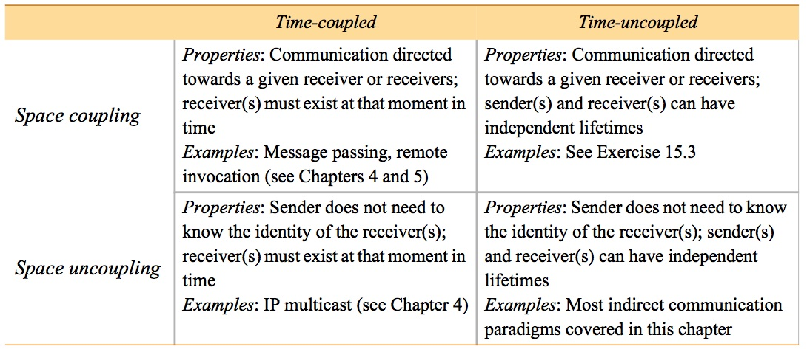
Definition
Communication between entities in a distributed system through an intermediary with no direct coupling between the sender and the receiver(s)

Slide 4
Group Communication
A message is sent to a group and then delivered to all members of the group
Applications
Reliable dissemination of informations
Support for collaborative applications
Support for fault tolerant strategies
Support for system monitoring and management

Slide 5
Programming model
Concepts
Group
Group membership
Join/leave operations
Multicast communication
One operation to send many messages
Allows different kind of optimisation
Allows to provide guarantees (delivery, ordering)

Slide 6
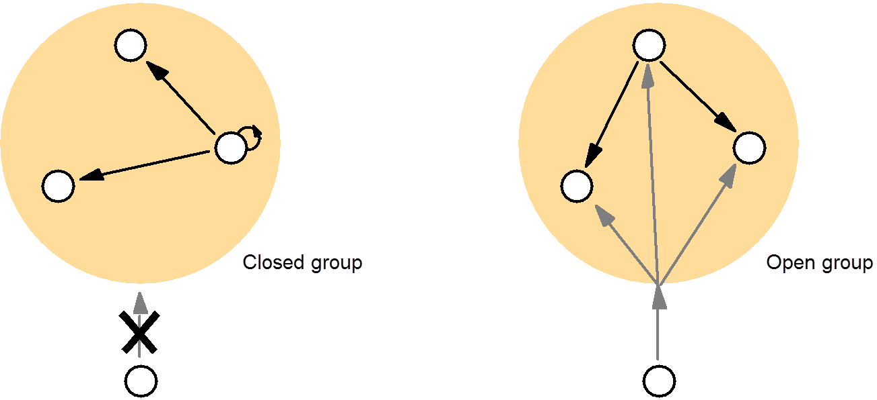
Kind of group services
Process vs Object groups
Open vs Closed Groups
Overlapping vs non-overlapping groups
Synchronous vs asynchronous systems

Slide 7
Implementation issues
Reliability
Integrity (same message sent and received)
Validity (It is eventually delivered)
Agreement (If it is delivered to one process it is delivered to all)
Ordered Multicast
FIFO ordering
Causal ordering
Total ordering

Slide 8
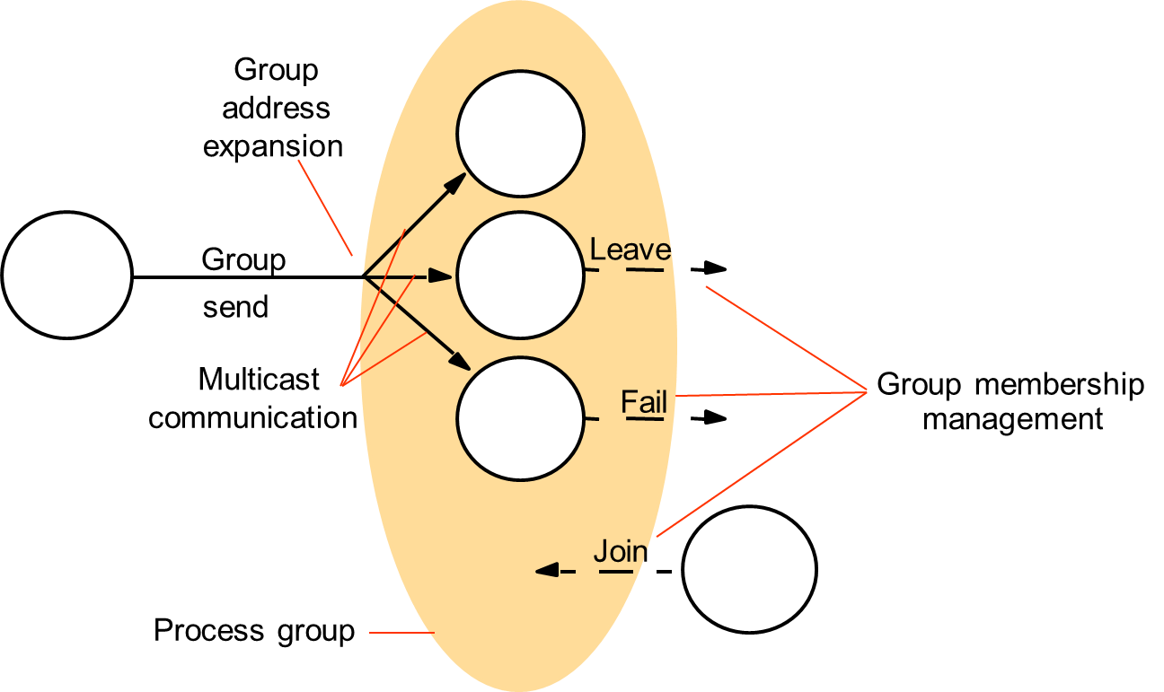
Implementation issues
Group membership management

Slide 9
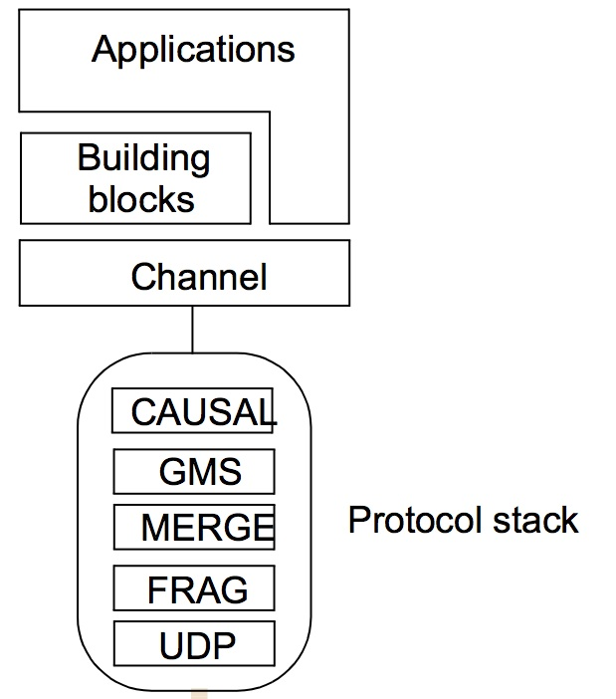
Example : Jgroup toolkit
Toolkit for reliable communication in Java
http://www.jgroups.org/movies/ReplCache.swf

Slide 10
Publish-Subscribe Systems
Distributed event based system
A publisher publish events to an event service
Subscribers express interest in events through subscription
The system match subscriptions to events and ensure the delivery
Application
Financial information systems
Cooperative work
Ubiquitous computing
Monitoring

Slide 11
Example

Slide 12
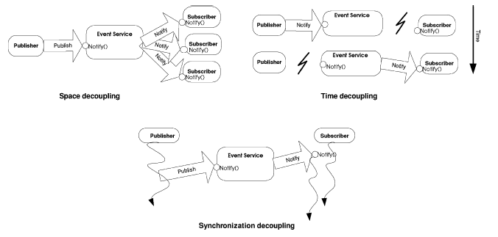
Decoupling in time and Space

Slide 13
Classification of Pub/Sub Architectures
Centralized Broker model
Consists of multiple publishers and multiple subscribers and centralized broker/brokers (an overlay network of brokers interacting with each other).
Subscribers/Publishers will contact 1 broker, and does not need to have knowledge about others.
E.g. CORBA event services, JMS, JEDI etc…

Slide 14
Classification of Pub/Sub Architectures
Peer-to-Peer model
Each node can be publisher, subscriber or broker.
Subscribers subscribe to publishers directly and publishers notify subscribers directly. Therefore they must maintain knowledge of each other.
Complex in nature, mechanisms such as DHT and CHORD are employed to locate nodes in the network.
E.g. Java distributed event service

Slide 15
Key functions implemented by P/S middleware service
Event filtering (event selection)
The process which selects the set of subscribers that have shown interest in a given event. Subscriptions are stored in memory and searched when a publisher publishes a new event.
Event routing (event delivery)
The process of routing the published events from the publisher to all interested subscribers

Slide 16
Event Filtering (Subscription Model) Topic based VS Content based
Topic based
Generally also known as topic based, group based or channel based event filtering.
Each event is published to one of these channels by its publisher.
Subscribers subscribes to a particular channel and will receive ALL events published to the subscribed channel.

Slide 17
Topic-based subscription
Simple process for matching an event to subscriptions. However, limited expressiveness.
Event filtering is easy, event routing is difficult (Heavy load on the network). The challenge is to multicast event effectively to subscribers.

Slide 18
Event Filtering- Subscription Model Topic based VS Content based
Content based
More flexibility and power to subscribers, by allowing more expression in arbitrary/customized query over the contents of the event.
Event publication by a key/value attribute pair, and subscriptions specify filters using a explicit subscription language.
E.g. Notify me of all stock quotes of IBM from New York stock exchange if the price is greater than 150

Slide 19
Content-based Subscription
Added complexity in matching an event to subscriptions. (Implementation: Subscription arranged in a matching tree, where each node is a partial condition.
However, more precision is provided and event routing is easier

Slide 20
Event Routing
After filtering the events, the broker/brokers must route the events to the corresponding subscribers.
Can be done in the following ways:
Unicast
Multicast
Server push/ client pull

Slide 21
Event Routing
The broker makes the decision: how to route the message to the subscriber.
Several optimization schemes are available.
Profile forwarding scheme – brokers only forward the event to their neighbor broker which fulfill their subscription
Filtering the total covering of the subscription of the system – accept publisher events only if a subscriber has subscribed this event.

Slide 22
Advantages of Pub/Sub
Highly suited for mobile applications, ubiquitous computing and distributed embedded systems
Robust – Failure of publishers or subscribers does not bring down the entire system
Scalability- Suited to build distributed applications consisting a large number of entities
Adaptability- can be varied to suit different environments (mobile, internet game, embedded systems etc…)

Slide 23
Disadvantages of Pub/Sub
Reliability – no strong guarantee on broker to deliver content to subscriber. After a publisher publishes the event, it assumes that all corresponding subscribers would receive it.
Potential bottleneck in brokers when subscribers and publishers overload them. (Solve by load balancing techniques)
Security an issue:
Encryption hard to implement when the brokers has to filter out the events according to context.
Brokers might be fooled into sending notifications to the wrong client, amplifying denial of service requests against the client.

Slide 24
Conclusion
Distributed Pub/Sub System provides a loosely-coupled, asynchronous model which is useful in many fields of network utilization.
Several areas are still open for research:
Effective routing and filtering algorithms for better performance
Scalability versus expressiveness issue
Fault tolerance
Security

Slide 25
References
Papers:
P.Eugster, P.Felber,RGuerraoui and A.Kermarrec. The Many Faces of Publish/Subscribe. In ACM Computing Surveys, Vol. 35, No.2, June 2003.
A.Carzaniga, D.Rosenblum, A.Wolf . Design and Evaluation of a Wide-Area Event Notification Service. ACM Transactions on Computer Systems, Vol. 19, No. 3, August 2001.
Wikipedia:
http://en.wikipedia.org/wiki/Publish/subscribe

Slide 26
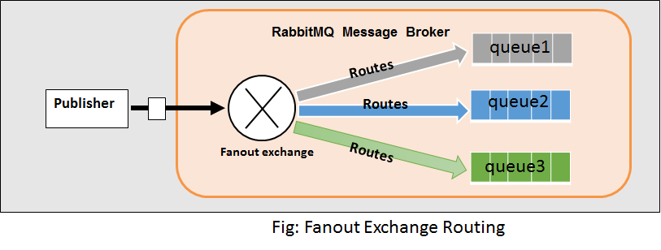
Fan-Out pattern (RabbitMQ)
https://www.rabbitmq.com/tutorials/tutorial-three-spring-amqp.html

Slide 27
Message queues
Message Oriented Middleware
Used for Enterprise Application Integration (EAI)
AMQP – Advanced Message Queuing protocol (Open Standard)

Slide 28
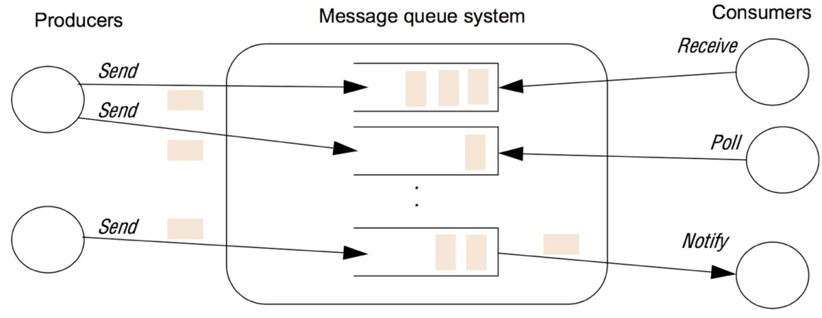
Programming model
A producer sends a message to a queue
Consumer receive messages from queue(s)
Style of receive
Blocking receive
Non Blocking receive
Notify

Slide 29
Programming model
Message are persistent
Reliable delivery : a message sent will eventually be delivered
Validity
Integrity
Can be transactional
Can be secure

Slide 30

Message oriented approach
Non blocking request
Low Coupling
Safety
Many sender/receiver
Lower performance (indirection)

Slide 31
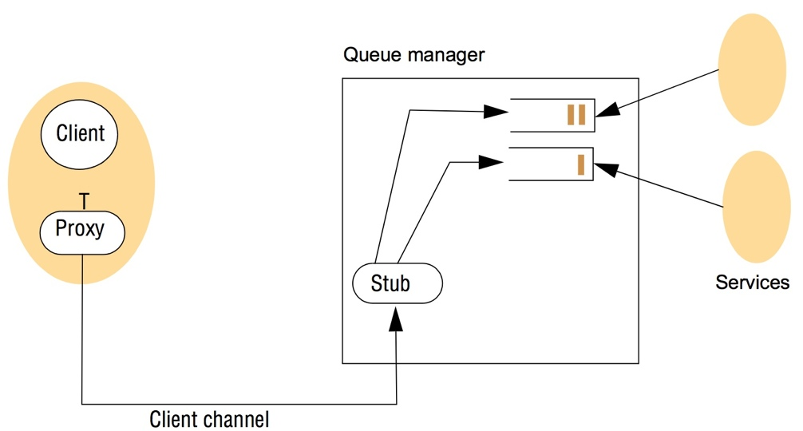
Implementation issue
Centralized vs Distributed

Slide 32

Example RabbitMQ (from their web site)
Hello world Spring Version

Slide 33
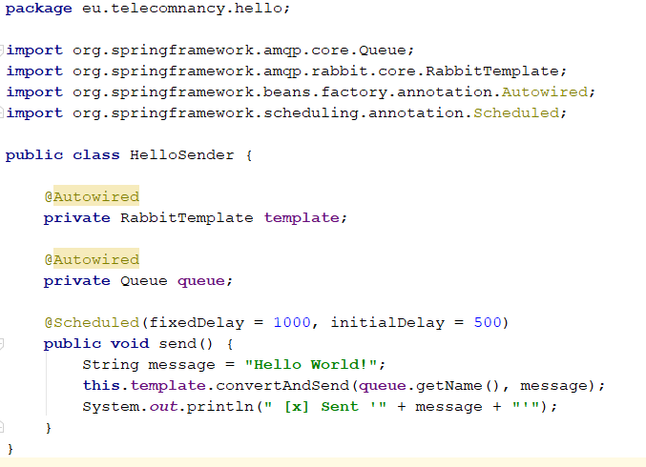
RabbitMQ Spring Sender

Slide 34
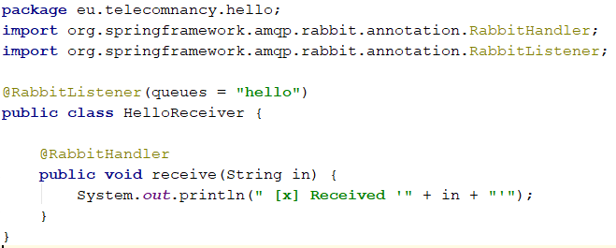
RabbitMQ Spring Receiver

Slide 35
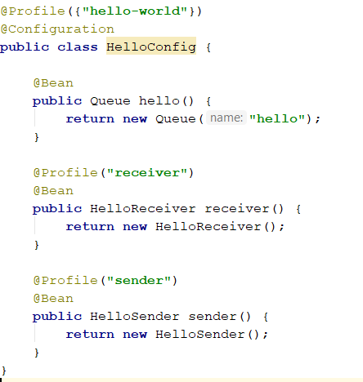
RabbitMQ Spring Config

Slide 36
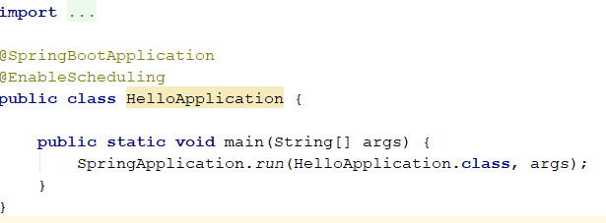
RabbitMQ Spring main

Slide 37
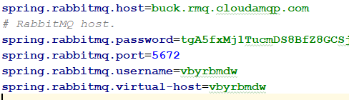
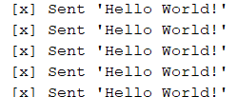

Connection properties

Slide 38
Delivery guarantee
A message sent will eventually be delivered
A message is sent
It is consumed
If the MOM does not receive a ack it is put back in the queue
Alternative
Certified message delivery
Store and Forward

Slide 39
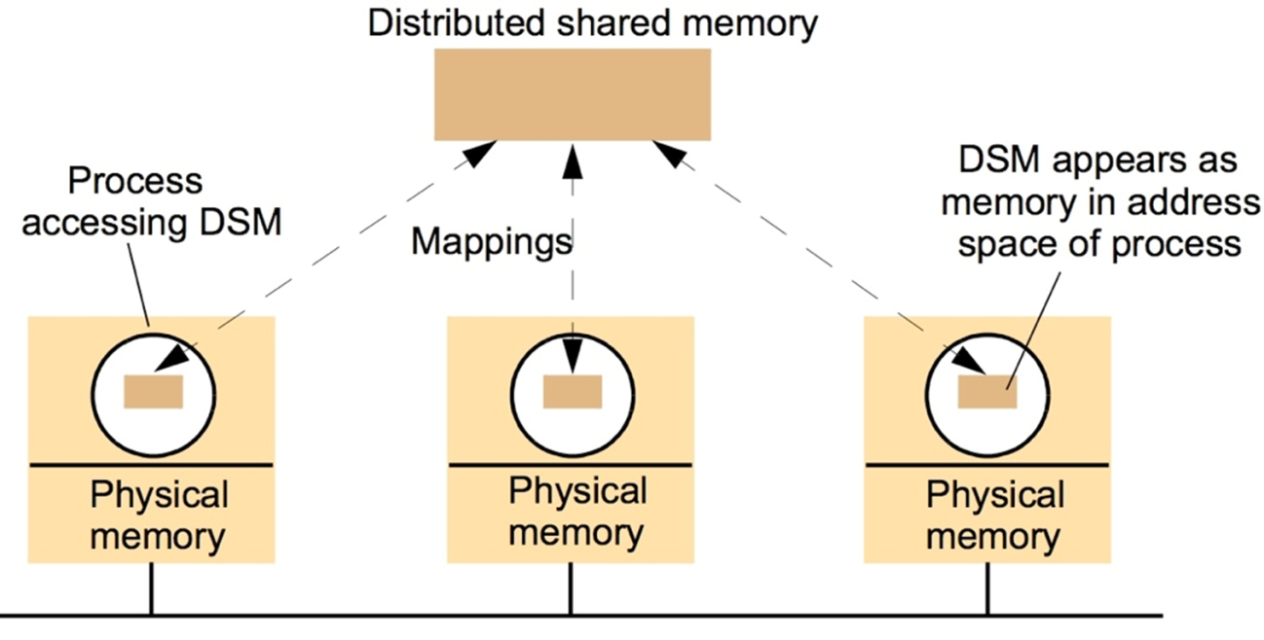
Shared Memory
Distributed shared memory
Developed for parallel computing
Sharing data between computer that do not share physical memory

Slide 40
Tuple Space Communication
Process communicate by placing tuple in a tuple space
Linda, JavaSpaces, TSpaces

Slide 41
Programming model
A tuple is a sequence of typed data field
A tuple space contains tuples
Operations
Write (add a tuple)
Read
Take (remove the tuple)
Access to tuple is associative
Tuples are immutable

Slide 42
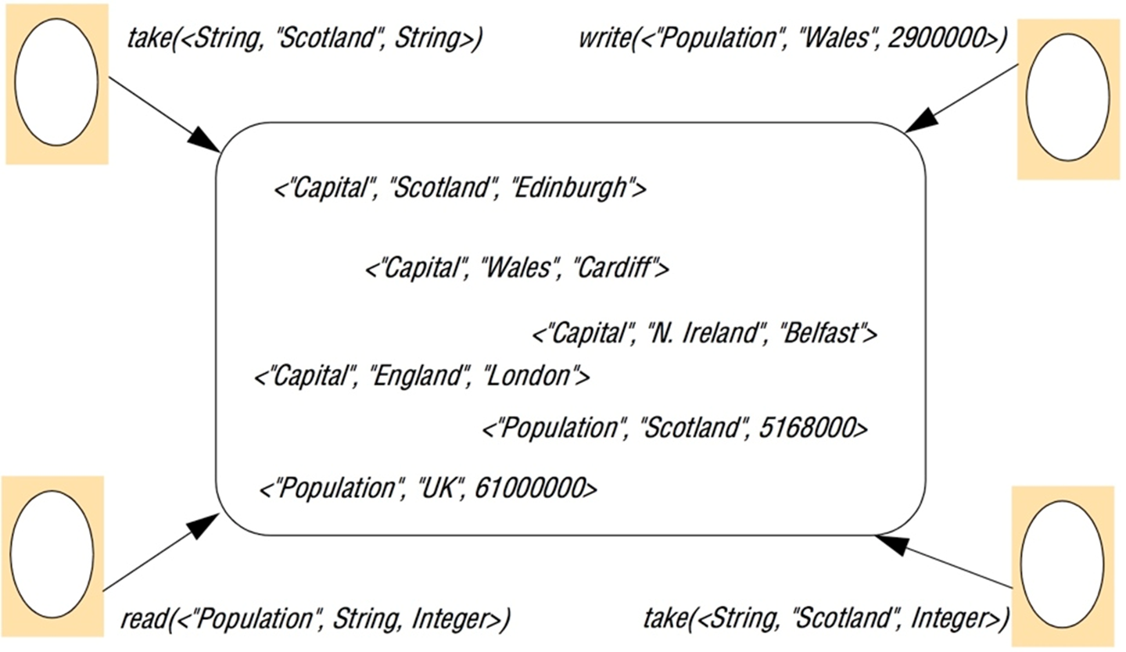
Example

Slide 43
Implementation issues
Centralized : Single point of failure/Do not scale
Distributed : replication using
A totally ordered multicast algorithm
Or partitioning of spaces (Xu and Liskov)

Slide 44
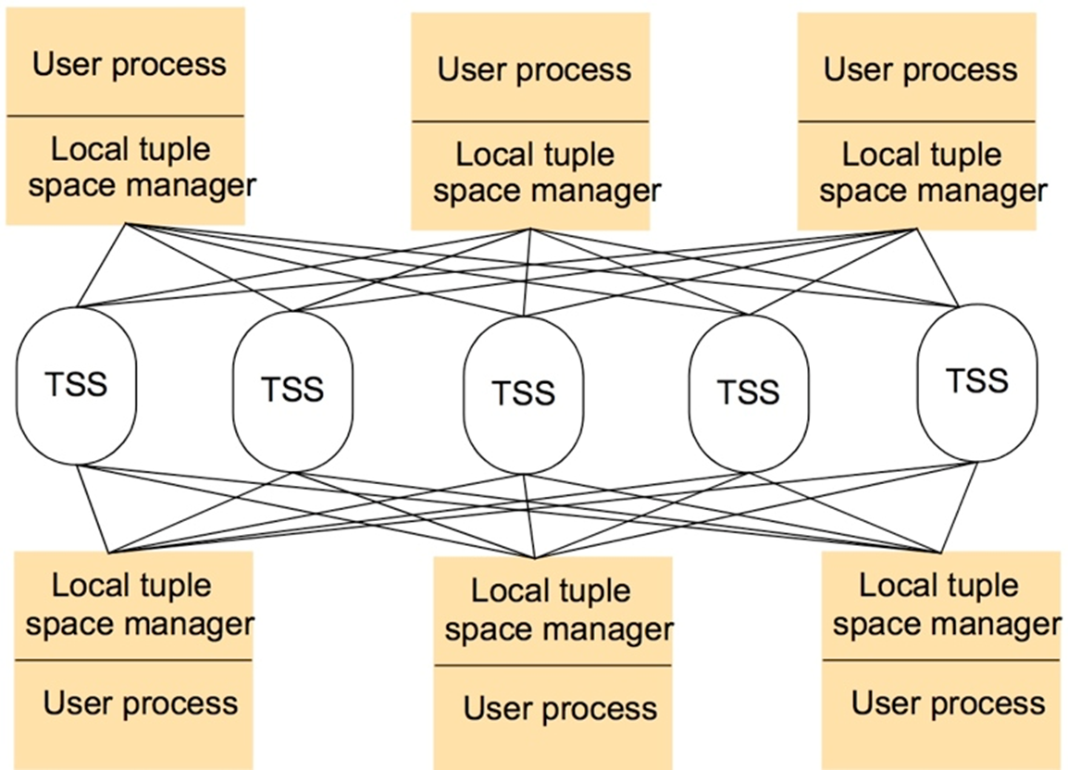
York Linda Kernel

Slide 45
Summary
Indirect communication lead to interesting properties
Space and Time uncoupling

Slide 46
